Slide 1
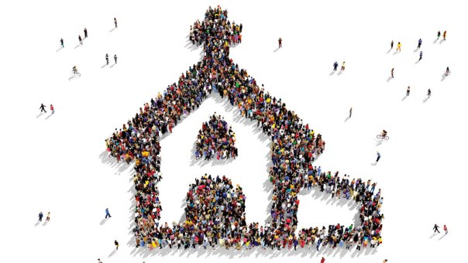
Neurodiversity in the Kingdom of God
Kim Marxhausen, PhD
Concordia Deaconess Conference
June, 2023

Slide 2
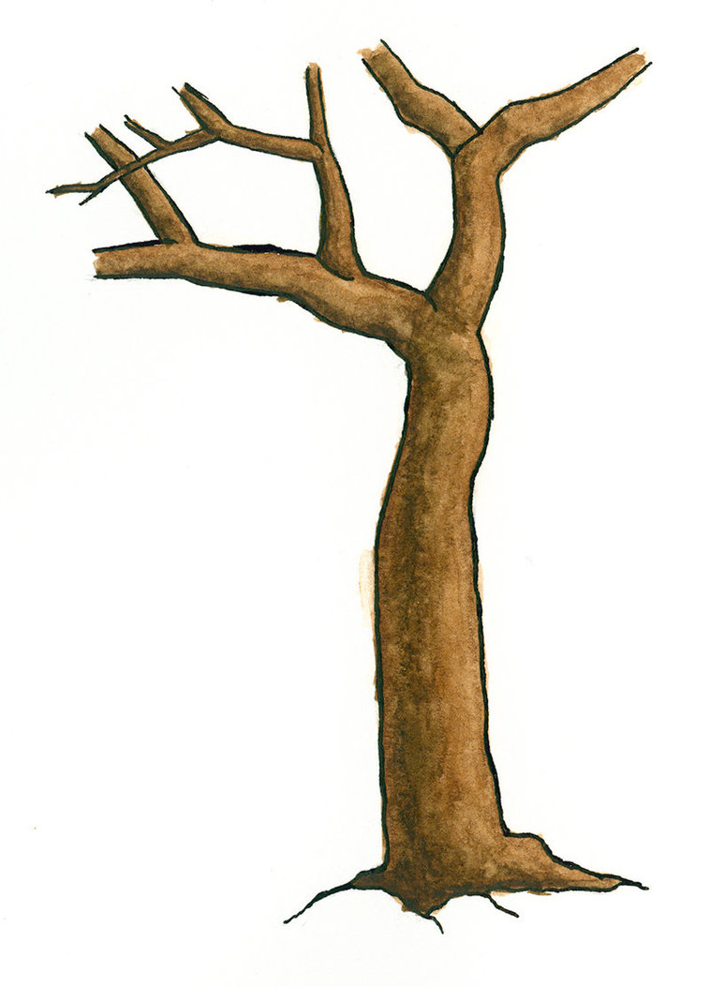
Now there are varieties of gifts, but the same Spirit; and there are varieties of service, but the same Lord; and there are varieties of activities, but it is the same God who empowers them all in everyone.
I Corinthians 12: 4-6

Slide 3
Neurodiversity
“What we see depends mainly on what
we look for.” Sir John Lubbock
Disorder
Difference
Problem
Fix
Accommodation
Benefit

Slide 4
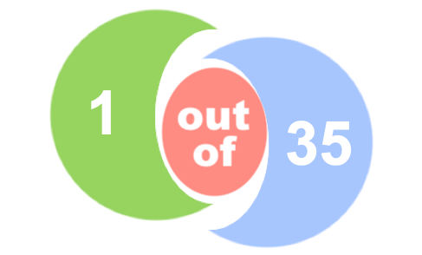
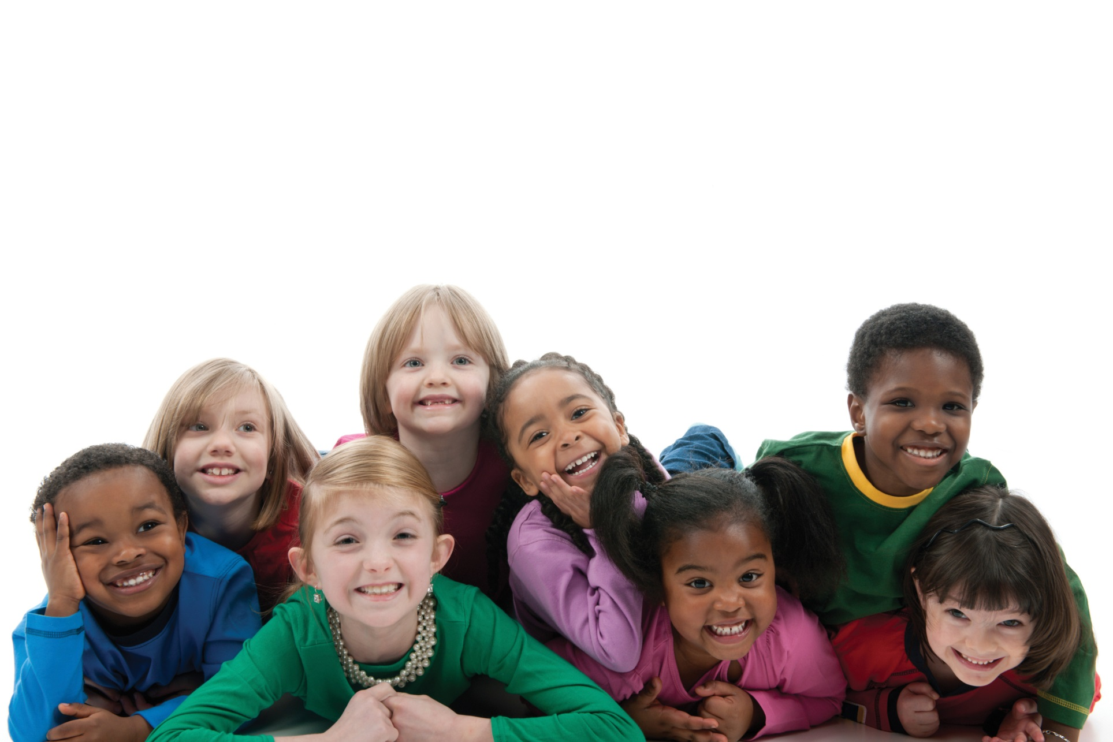
Autism Spectrum Disorder (ASD)

Slide 5
Autism Spectrum Disorder (ASD)
Mild
Severe
Asperger's
Autism
High Functioning
Low Functioning

Slide 6
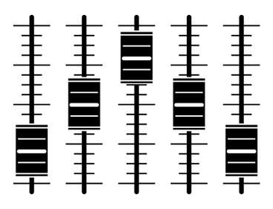
Neurodiverse Model
Soundboard
Social communication/interaction
Circumscribed interest
Aggression/rigidity
Sensory processing challenges
Notes:
15

Slide 7
Neurodiverse Model
Traffic Jam
Too much sensory information impedes thinking
Sensory memory
Workbench
Long term memory

Slide 8
Meltdown
A developmentally uncharacteristic behavior
that demands attention
and must be addressed
Fight
Crying fit
Self-harm
Anger/sarcasm
Flight
Run
Hide
Withdraw
Freeze
Refuse
Delay
Control

Slide 9
Uniquely Made for God’s Purpose

Slide 10
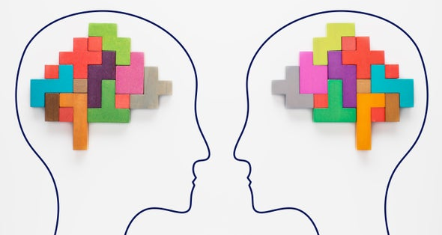
Uniquely Made: Solo Learner
Solo Learning Social Learning
Creating concepts
Factual information
Systems/patterns
Regulate focus
Language
Social skills (ambiguity)
Regulate body, emotion

Slide 11
Uniquely Made: Attention Allocation
Simultaneous attention:
Sensory information
Social information
Planning and motivation
Polytropic
Allocating most attention to one thing
State of flow (creativity)
Monotropic

Slide 12
Solo Learning and Monotropic Challenges
World designed for what is typical
Expectations to be the same create:
Anxiety
Panic

Slide 13
Solo Learning and Monotropic Benefits
 | Systems and patterns | Singular focus | Unique creativity | School a poor fit
Albert Einstein
Thomas Edison
Bill Gates
Steve Jobs
Notes:
AE dropped out of high school, entrance test for college had low scored for everything but M and P. Phd awarded on basis of thesis

Slide 14
At Home in the Kingdom of God

Slide 15
Fellowship
Belonging
Trust
Social Capital
Behavior

Slide 16
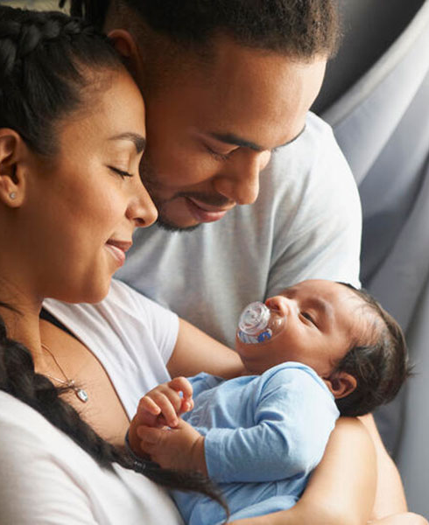
Belonging
Essential for:
Sense of self
Trust
Learning

Slide 17
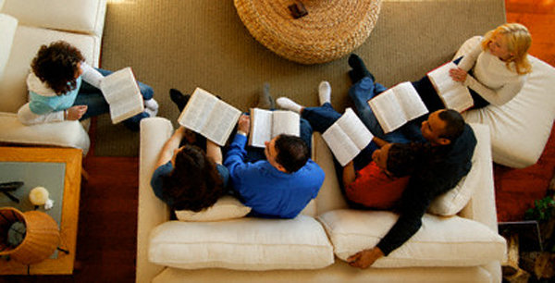
Belonging
Cared about and cared for
Skills valued
Unconditional love AND accountability

Slide 18
Social Capital
Relationships
Alliances
Reciprocity
Common purpose

Slide 19
Trust
Solo learner Social learner
Pattern of behavior no ambiguity
Watch the behavior before trusting the person
Pattern of behavior with ambiguity
Trust the person over the behavior

Slide 20
Behavior
Adaptive
Maladaptive
A behavior that enables a person to cope with the environment with the greatest success and the least conflict
A behavior that enables a person to cope with the environment
but causes harm, risk, or conflict.

Slide 21
Now there are varieties of gifts, but the same Spirit; and there are varieties of service, but the same Lord; and there are varieties of activities, but it is the same God who empowers them all in everyone. To each is given the manifestation of the Spirit for the common good.
I Corinthians 12: 4-7

Slide 22
Spiritual and emotional support for caregivers
Concordia
Publishing House
Amazon
Kindle

